Slide 1

CSE 111 Phase 1 Presentation:
Conference Management Database
By Kris Pichon & Zion Koundou

Slide 2

Main Use Cases

Slide 3

The database system we are designing is called the Conference Scheduling & Management Database

Slide 4


Main Use Cases
Streamline Scheduling: The main goal of this project is to organize and automate scheduling processes for conferences.
Storage Management: Instead of tracking everything manually, this system stores data about sessions, rooms, and speakers in a relational database.

Slide 5


Main Use Cases (Continued)
Organization: Our database ensures there are no double-booked rooms or overlapping sessions.
Tracking: It also keeps an up to date record of every update made by administrators or schedulers.

Slide 6
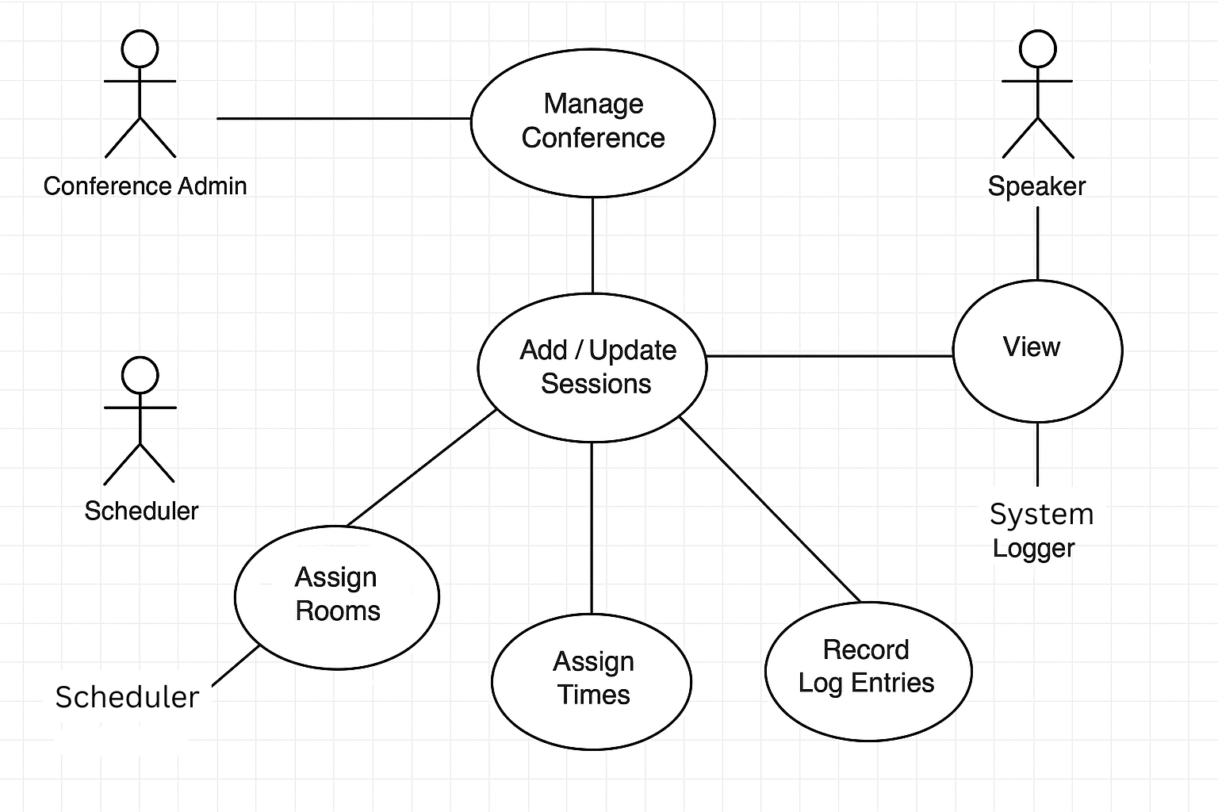
UML Diagram
This UML use-case diagram shows how each type of user interacts with the system:
The Conference Admin manages the main conference details
The Scheduler assigns rooms and session times.
Speakers can view their scheduled sessions
System Logger automatically records all updates for accountability

Slide 7
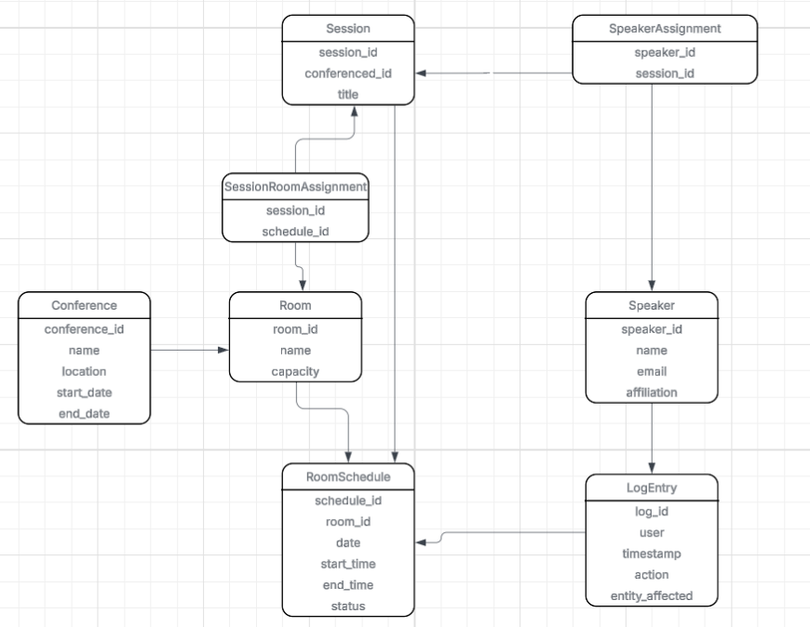
E/R Diagram
The E/R diagram that represents the logical structure of the database
This ensures the design stays normalized and avoids redundant data.
8 Entities :
Conference
Session
Room
RoomSchedule
SessionRoomAssignment
Speaker
SpeakerAssignment
LogEntry

Slide 8
E/R Diagram
5. RoomSchedule → SessionRoomAssignment
(One-to-Many)
6. Session ↔ RoomSchedule (Many-to-Many via SessionRoomAssignment)
7. Speaker → SpeakerAssignment (One-to-Many)
8. Session ↔ Speaker
(Many-to-Many via
SpeakerAssignment)
8 relationships:
6 one-to-many,
2 many-to-many
1. Conference → Session (One-to-Many)
2. Room → RoomSchedule (One-to-Many)
3. RoomSchedule → LogEntry
(One-to-Many)
4. Session → SessionRoomAssignment (One-to-Many)

Slide 9

Functionality In-Depth

Slide 10

Manage Conference
Primary Actor - Conference Admin
Create, update, or delete conference records including location and duration.
For example: a natural disaster may stop the conference from being held and so a conference admin would be able to move the date of the whole conference to another.

Slide 11


Add & Update Sessions
Primary Actor - Admin & Scheduler
Add new sessions or edit existing ones, linking them to conferences.
For example: A new speaker wants a session in the conference. The scheduler/admin can add a new session and link it to whatever conference and room they want it to be held at.

Slide 12

Assign Rooms
Primary Actor - Scheduler
Match sessions with available rooms, recording time and capacity constraints
For example: a speaker needs to switch rooms because they won't make it to that side of the area that the conference is held. In that case the scheduler would be able to assign a different room to the speaker

Slide 13

Assign Times
Primary Actor - Scheduler
Schedule sessions at specific start/end times while avoiding overlaps
For example: A speaker could be busy the time that he has scheduled. The scheduler could move the sessions time earlier or later to accommodate the speaker.

Slide 14

View Schedule
Primary Actor - Speaker
Display sessions with assigned speakers, rooms, and times
For example: The speaker forgot what time and location their session starts. They can view the schedule to know that information.

Slide 15

Record Log Entries
Primary Actor - System Logger
Automatically capture, create, update, and delete actions in the system log
For example: Let's say a session got deleted somewhere. The system logger would be able to retrieve when it was deleted in the system log.

Slide 16
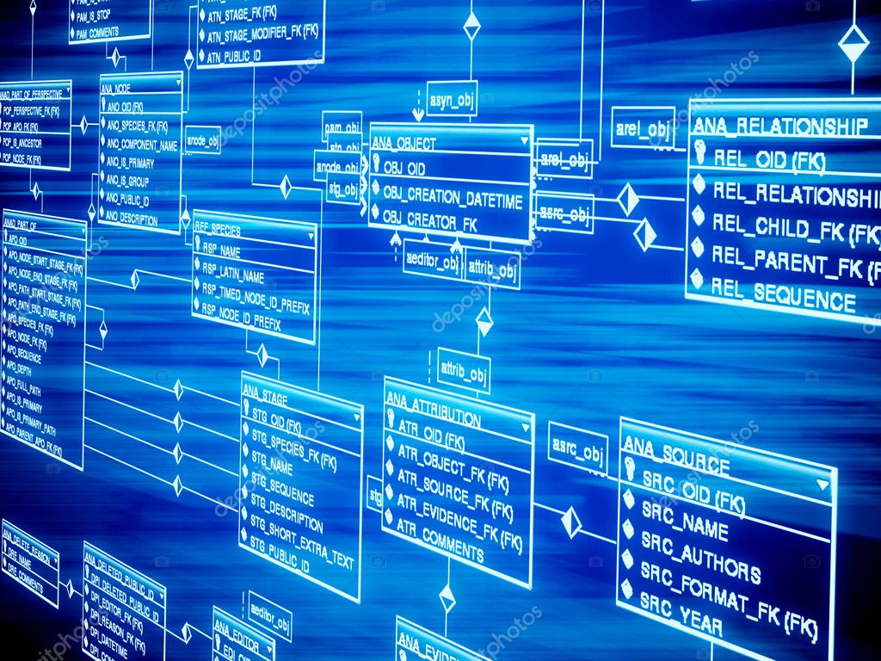
Relations Tables
Each entity from the E/R diagram was converted into a corresponding database table.
Primary keys uniquely identify each record, and foreign keys maintain the relationships between them.

Slide 17
Relations Tables
Conference
Attributes | Keys | Relationships
conference_id, name, location, start_date, end_date | PK: conference_id | Referenced by Session

Slide 18
Session
Attributes | Keys | Relationships
session_id, conference_id, title, start_time, end_time | PK: session_id FK: conference_id → Conference | Has many Speakers, Rooms

Slide 19
Room
Attributes | Keys | Relationships
room_id, name, capacity, building, floor | PK: room_id | Linked via RoomSchedule

Slide 20
RoomSchedule
Attributes | Keys | Relationships
schedule_id, room_id, session_id, start_time, end_time, status | PK: schedule_id FKs: room_id → Room, session_id → Session | Logs all scheduling activity

Slide 21
Speaker
Attributes | Keys | Relationships
speaker_id, name, email, affiliation | PK: speaker_id | Linked via SpeakerAssignment

Slide 22
SpeakerAssignment
Attributes | Keys | Relationships
speaker_id, session_id | PK: (speaker_id, session_id) FKs: speaker_id → Speaker, session_id → Session | M:N bridge table

Slide 23
LogEntry
Attributes | Keys | Relationships
log_id, user, timestamp, action, entity_affected, details | PK: log_id | Independent audit trail

Slide 24
RELATIONS TABLES SUMMARY
# | Relationship | Type | Explanation
1 | Conference → Session | 1:N (One-to-Many) | Session includes conference_id (FK) → many sessions per one conference.
2 | Session → RoomSchedule | 1:N (One-to-Many) | RoomSchedule stores session_id → many room logs per one session.
3 | Room → RoomSchedule | 1:N (One-to-Many) | RoomSchedule stores room_id → many session bookings per room.
4 | Session → SpeakerAssignment | 1:N (One-to-Many) | Each session can have multiple speaker links.
5 | Speaker → SpeakerAssignment | 1:N (One-to-Many) | Each speaker can appear multiple times in assignments.
6 | Session ↔ Room (via RoomSchedule) | M:N (Many-to-Many) | One session may occur in multiple rooms, and rooms may host multiple sessions — resolved by RoomSchedule.
7 | Session ↔ Speaker (via SpeakerAssignment) | M:N (Many-to-Many) | One session can have many speakers; one speaker can join many sessions — resolved by SpeakerAssignment.

Slide 25
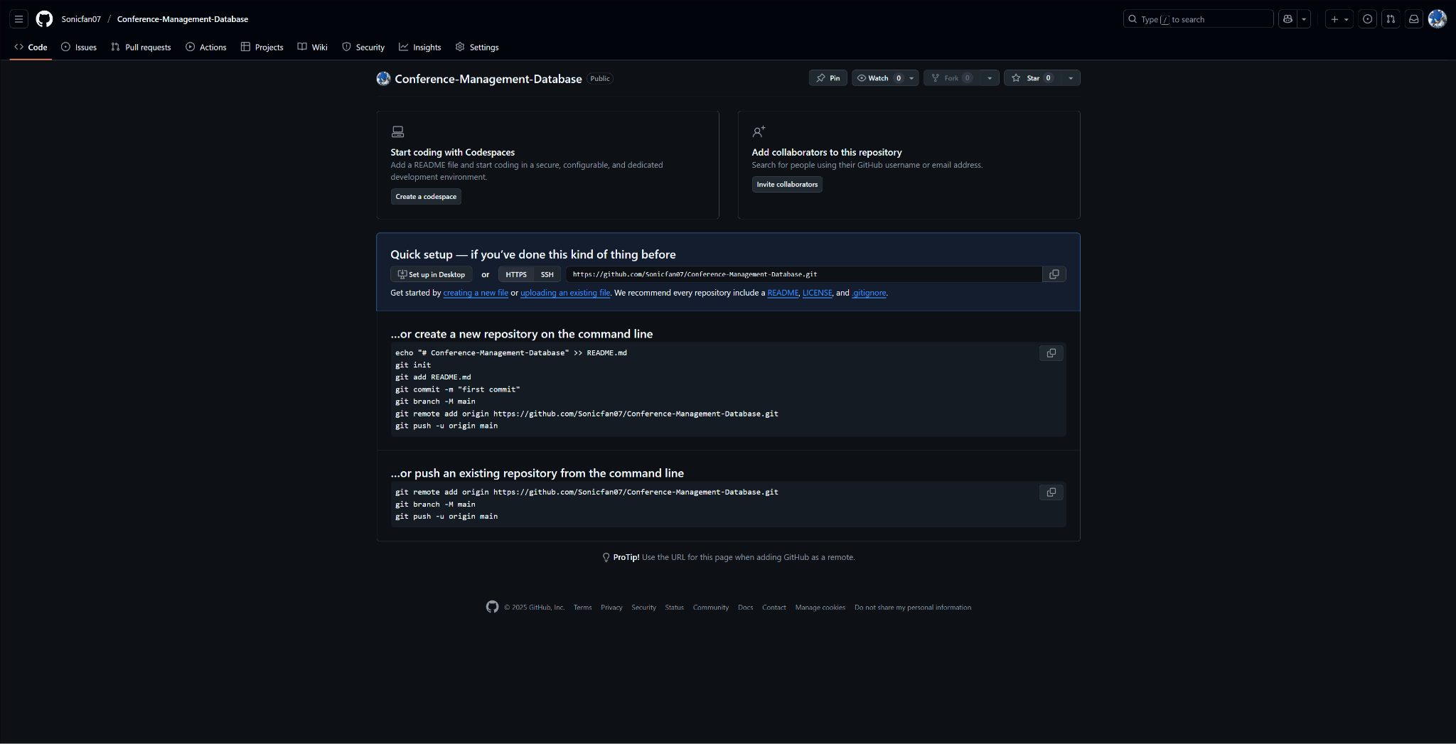
Github Showcase

Slide 26

What’s Next?
. Tables will be created in SQLite or MySQL
. Data will be inserted for testing
. Proceed to Phase 2

Slide 27
In Conclusion…
This project creates a reliable and transparent system for managing conferences.
It connects sessions, rooms, and speakers in one relational structure and automatically logs every change.
This approach ensures efficiency, consistency, and accountability throughout the entire scheduling process.

Slide 28
Thank you for your time!!

